Slide 1



Noida Institute of Engineering and Technology, Greater Noida
Concept of CCS & Bootstrap
Unit: 3
Web Technology (ACSE0505) )
Deepshikha
Assistant Professor
CSE
NIET, Greater Noida
Course Details (B Tech 5th Sem)

Slide 2

Table of Contents
Name of Subject with code, Course and Subject Teacher
Brief Introduction of Faculty member with Photograph
Evaluation Scheme
Subject Syllabus
Branch wise Applications
Course Objective (Point wise)
Course Outcomes (COs)
Program Outcomes only heading (POs)
COs and POs Mapping
Program Specific Outcomes (PSOs)
2

Slide 3
Conti….
COs and PSOs Mapping
Program Educational Objectives (PEOs)
Result Analysis (Department Result, Subject Result and Individual Faculty Result)
End Semester Question Paper Templates (Offline Pattern/Online Pattern)
Perquisite/ Recap
Brief Introduction about the Subject with videos
Unit Content
Unit Objective
Topic Objective/Topic Outcome
Lecture related to topic
Daily Quiz
Weekly Assignment

Slide 4
Conti…
Topic Links
MCQ (End of Unit)
Glossary Questions
Old Question Papers (Sessional + University)
Reference
Recap of Unit

Slide 5

Brief Introduction of Faculty
I am pleased to introduce myself as Deepshikha Dhillon, presently associated with NIET, Greater Noida as Assistant Professor in CSE Department.
I completed my M.Tech. degree form Galgotias University, Lucknow in 2022. I have been working in NIET Greater Noida for last 6 Month.
My area of interest is related to Software Engineering.

Slide 6
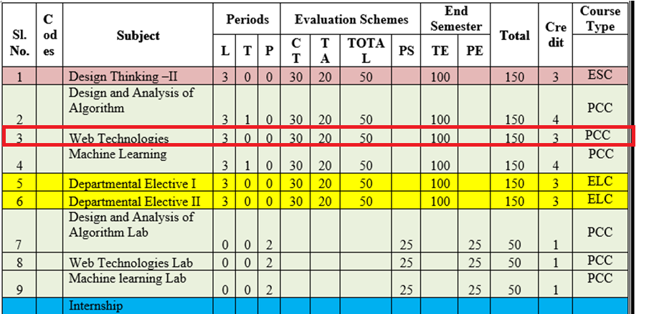
Evaluation Scheme

Slide 7
Syllabus Unit -1
8 Hours
Introduction: Introduction to Web Technology, History of Web and Internet, Connecting to Internet, Introduction to Internet services and tools, Client-Server Computing, Protocols Governing Web, Basic principles involved in developing a web site, Planning process, Types of Websites, Web Standards and W3C recommendations.
Web Hosting: Web Hosting Basics, Types of Hosting Packages, Registering domains, Defining Name Servers, Using Control Panel, Creating Emails in Cpanel, Using FTP Client, Maintaining a Website.

Slide 8
Syllabus Unit -2
8 Hours
HTML: What is HTML, DOM- Introduction to Document Object Model, Basic structure of an HTML document, Mark up Tags, Heading-Paragraphs , Line Breaks, Understand the structure of HTML tables. Lists, Working with Hyperlinks, Image Handling, Understanding Frames and their needs, HTML forms for User inputs. New form Elements- date, number, range, email, search and data list, Understanding audio, video and article tags.
XML: Introduction, Tree, Syntax, Elements, Attributes, Namespaces, Display, HTTP request, Parser, DOM, XPath, XSLT, XQuerry, XLink, Validator, DTD, Schema, Server

Slide 9
Syllabus Unit -3
8 Hours
Concept of CSS 3: Creating Style Sheet, CSS Properties,CSS Styling(Background, Text Format, Controlling Fonts) , Working with block elements and objects , Working with Lists and Tables , CSS Id and Class, Box Model(Introduction, Border properties, Padding Properties, Margin properties) CSS Advanced(Grouping, Dimension, Display, Positioning, Floating, Align, Pseudo class, Navigation Bar, Image Sprites, Attribute sector) , CSS Color, Creating page Layout and Site.
Bootstrap: Introduction, Bootstrap grid system, Bootstrap Components.

Slide 10
Syllabus Unit -4
8 Hours
JavaScript Essentials: Introduction to Java Script , Java script Types , Var, Let and Const Keywords, Operators in JS , Conditions Statements , Java Script Loops, JS Popup Boxes , JS Events , JS Arrays, Working with Arrays, JS Objects ,JS Functions , Using Java Script in Real time , Validation of Forms, Arrow functions and default arguments, Template Strings, Strings methods, Callback functions,
Object de-structuring, Spread and Rest Operator, Typescript fundamentals, Typescript OOPs- Classes, Interfaces, Constructor etc. Decorator and Spread Operator,
Difference == & ===, Asynchronous Programming in ES6, Promise Constructor, Promise with Chain, Promise Race.

Slide 11
Syllabus Unit -5
8 Hours
Introduction to PHP, Basic Syntax, Variables & Constants, Data Type, Operator & Expressions, Control flow and Decision making statements, Functions, Strings, Arrays,
Working with files and directories: Understanding file& directory, Opening and closing, a file, Coping, renaming and deleting a file, working with directories, Creating and deleting folder, File Uploading & Downloading.
Session & Cookies: Introduction to Session Control, Session Functionality What is a Cookie, Setting Cookies with PHP. Using Cookies with Sessions, Deleting Cookies, Registering Session variables, Destroying the variables and Session.

Slide 12
Text Books
Text books:
1. Steven M. Schafer, “HTML, XHTML, and CSS Bible, 5ed”, Wiley India
2. Ian Pouncey, Richard York, “Beginning CSS: Cascading Style Sheets for Web Design”, Wiley India

Slide 13
Branch Wise Applications
Sample Applications
Desktop GUI Applications
Mobile Applications
Enterprise Applications
Scientific Applications
Web-based Applications
Cloud-based Applications
Web servers and Application servers
Software Tools

Slide 14
Course Objective
This course covers different aspect of web technology such as HTML, CSS, and issues of web technology, client and server side issue.
The general objectives of this course are to provide fundamental concepts of Internet; Web Technology and Web Programming.
Students will be able to build a proper responsive website.

Slide 15
Course Outcome
At the end of the semester, student will be able to:
Course Outcomes (CO) | CO Description | Blooms’ Taxonomy
CO1 | Recalling the basic facts and explaining the basic ideas of Web technology and web hosting. | K2
CO2 | Applying and creating various HTML5 semantic elements and application with working on HTML forms for user input. | K6
CO3 | Understanding and applying the concepts of Creating Style Sheet (CSS)3 and bootstrap. | K3
CO4 | Analysing and implementing concept of Java Script and its applications. | K5
CO5 | Creating and evaluating dynamic web pages using the concept of PHP | K6

Slide 16
Program Outcome
1. Engineering knowledge:
2. Problem analysis:
3. Design/development of solutions:
4. Conduct investigations of complex problems:
5. Modern tool usage:
6. The engineer and society:
7. Environment and sustainability:
8. Ethics:
9. Individual and team work:
10. Communication:
11. Project management and finance:
12. Life-long learning

Slide 17
CO-PO Mapping
Mapping of Course Outcomes and Program Outcomes:
 | PO1 | PO2 | PO3 | PO4 | PO5 | PO6 | PO7 | PO8 | PO9 | PO10 | PO11 | PO12
ACSE0505 1.1 | 3 | 2 | 2 | 1 | 1 | 1 | 1 | 1 | 3 | 3 | 2 | 3
ACSE0505 1.2 | 3 | 2 | 3 | 1 | 3 | 2 | 2 | 1 | 3 | 3 | 3 | 3
ACSE0505 1.3 | 3 | 2 | 3 | 2 | 3 | 2 | 2 | 2 | 3 | 3 | 2 | 3
ACSE0505 1.4 | 3 | 3 | 3 | 2 | 3 | 2 | 2 | 2 | 3 | 3 | 2 | 3
ACSE0505 1.5 | 3 | 3 | 3 | 2 | 3 | 2 | 2 | 2 | 3 | 3 | 2 | 3
Average | 3 | 2.4 | 2.8 | 1.6 | 2.6 | 1.8 | 1.8 | 1.6 | 3 | 3 | 2.2 | 3

Slide 18
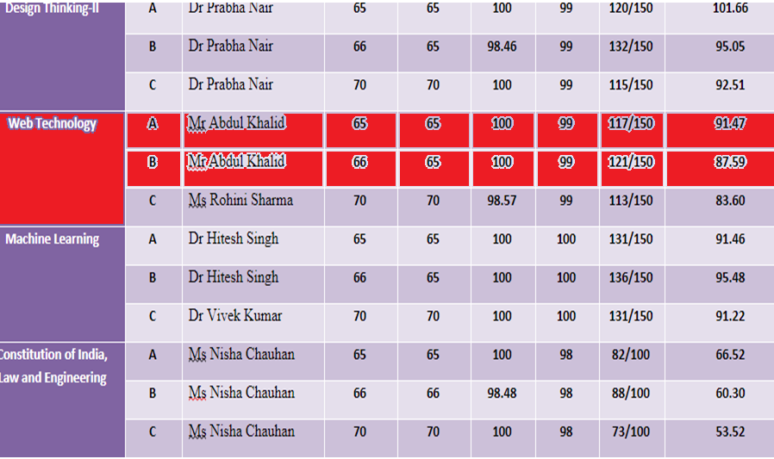
Result Analysis(2022-23)

Slide 19
Program Specific Outcomes
PSO1: Work as a software developer, database administrator, tester or networking engineer for providing solutions to the real world and industrial problems.
PSO2:Apply core subjects of information technology related to data structure and algorithm, software engineering, web technology, operating system, database and networking to solve complex IT problems.
PSO3:Practice multi-disciplinary and modern computing techniques by lifelong learning to establish innovative career.
PSO4: Work in a team or individual to manage projects with ethical concern to be a successful employee or employer in IT industry.

Slide 20
COs and PSOs Mapping
Mapping of Program Specific Outcomes and Course Outcomes:
Course Outcomes | Program Specific Outcomes
 | PSO1 | PSO2 | PSO3 | PSO4
CO1 | 3 | 3 | 2 | 3
CO2 | 3 | 3 | 3 | 2
CO3 | 3 | 3 | 2 | 2
CO4 | 3 | 2 | 3 | 2
CO5 | 3 | 2 | 2 | 2
AVG | 3 | 2.6 | 2.4 | 2.2

Slide 21
Program Educational Objectives
PEO1: able to apply sound knowledge in the field of information technology to fulfill the needs of IT industry.
PEO2:able to design innovative and interdisciplinary systems through latest digital technologies.
PEO3: able to inculcate professional and social ethics, team work and leadership for serving the society.
PEO4: able to inculcate lifelong learning in the field of computing for successful career in organizations and R&D sectors.

Slide 22
End Semester Question Paper Template
B TECH
(SEM-V) THEORY EXAMINATION 20__-20__
Time: 3 Hours Total Marks: 100
Note: 1. Attempt all Sections. If require any missing data; then choose suitably.
SECTION A
Attempt all questions in brief. 1 x 10 = 10
Q.No. | Question | Marks | CO
1 |  | 1
2 |  | 1
. |  | .
10 |  | 1

Slide 23
End Semester Question Paper Templates
2. Attempt of the following: 5 x 2 = 20
SECTION B
3. Attempt any five part of the following: 5 x 6 = 30
Q.No. | Question | Marks | CO
1 |  | 2
2 |  | 2
“”” |  | ‘”
5 |  | 2
Q.No. | Question | Marks | CO
1 |  | 6
. |  | 6
7 |  | 6

Slide 24
End Semester Question Paper Templates
4. Attempt any one part of the following: 1 x 10 = 10
5. Attempt any one part of the following: 1 x 10 = 10
6. Attempt any one part of the following: 1 x 10 = 10
Q.No. | Question | Marks | CO
1 |  | 10
2 |  | 10
Q.No. | Question | Marks | CO
1 |  | 10
2 |  | 10
Q.No. | Question | Marks | CO
1 |  | 10
2 |  | 10

Slide 25
End Semester Question Paper Templates
7. Attempt any one part of the following: 1 x 10 = 10
8. Attempt any one part of the following: 1 x 10 = 10
Q.No. | Question | Marks | CO
1 |  | 10
2 |  | 10
Q.No. | Question | Marks | CO
1 |  | 10
2 |  | 10

Slide 26
Prerequisite
Basic Knowledge of any programming language like C/C++/Python/Java. .
Familiarity with basic concepts of Internet.

Slide 27
Brief Introduction About The Subject
Web technologies are the various tools and techniques that are utilized in the process of communication between different types of devices over the internet.
To understand this term in a better manner, let’s break it down into two pieces: ‘web’ and ‘technology’.
The web, in this case, refers to the World Wide Web, more commonly known as WWW.
It first came into being in 1989 when famous scientist and engineer, Tim Berners-Lee, came up with an efficient mechanism to share resources between scientists all over the world.
https://www.youtube.com/results?search_query=Web+Technonogies

Slide 28
Unit 3 Content
Creating Style Sheet ,
CSS Properties , CSS Styling(Background, Text Format, Controlling Fonts),
Working with block elements and objects ,
Working with Lists and Tables , CSS Id and Class, Box Model (Introduction,Borderproperties,PaddingProperties,Marginproperties) ,
CSS Advanced(Grouping, Dimension, Display, Positioning, Floating, Align, Pseudo class, Navigation Bar, Image Sprites, Attribute sector),
CSS Color, Creating page Layout and Site,
Bootstrap:
Introduction, Bootstrap grid system,
Bootstrap Components..

Slide 29
Unit 3 Objective
Objective of Unit 3:
To learn about web development strategies with Creating style sheet, Creating Properties
To understand the basic concepts to develop the Working with block elements and objects.
To understand Bootstrapping and Bootstrapping Components.
To understand to register a domain and maintain CSS Style Sheet.

Slide 30
Topic Objective/Outcome
Objective of the above topics:
To get the knowledge about the CSS Style and Tools.
To know how to CSS with Bootstrapping Process.
To understand the components and their functionalities of CSS Advanced Grouping, dimensions, display.
To know the web standards to develop a website according to the CSS Pseudo class and image.

Slide 31
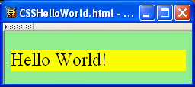
Concept of CSS 3: Creating Style Sheet
Cascading Style Sheets (CSS)
Applies to (X)HTML as well as XML documents in general
A styled HTML document. .
produced by the style sheet style1.css:
Deepshikha WT unit-3

Slide 32
Concept of CSS 3: Creating Style Sheet
Java Script is used insert dynamic text into HTML (ex: user name)
It’s get information about a user's computer (ex: browser type)
It perform calculations on user's computer (ex: form validation)
Java script offers a vast standard library that has a wide variety of functions and methods available to help in the process of development, making the entire process easier and hassle-free
Deepshikha WT unit- 3

Slide 33
Concept of CSS 3: Creating Style Sheet
Javascript is a lightweight, cross-platform, and interpreted language.
It was developed with the main intention of DOM manipulation, bringing forth the era of dynamic websites.
Javascript functions are objects and can be passed in other functions as parameters.
Can handle date and time manipulation.
Can perform Form Validation.
A compiler is not needed.
Deepshikha WT Unit- 3

Slide 34



Concept of CSS 3: Creating Style Sheet
+
=
Deepshikha WT unit- 3

Slide 35
Concept of CSS 3: Creating Style Sheet
Function expressions can be made "self-invoking".
A self-invoking expression is invoked (started) automatically, without being called.
Function expressions will execute automatically if the expression is followed by ().
You cannot self-invoke a function declaration.
we have to add parentheses around the function to indicate that it is a function expression:
Example
(function () { let x = "Hello!!"; // I will invoke myself })();

Slide 36
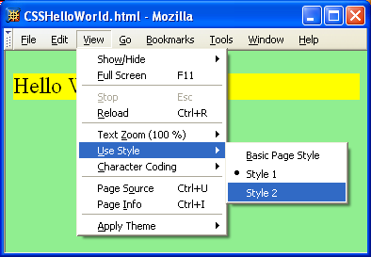
Concept of CSS 3: Creating Style Shee
Variables:-
variables are declared with the var keyword (case sensitive)
types are not specified, but JS does have types ("loosely typed")
Note that alternate,user selectable style is not widely supported:firefox 3 and IE 8 do,but IE 6 IE 7 and chrome don’t.
var name = expression; JS
var clientName = "Connie Client";
var age = 32;
var weight = 127.4; JS
Deepshikha WT unit3

Slide 37
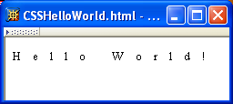
Concept of CSS 3: Creating Style Sheet
A styled HTML document
Vvvvvvvvvvvvvvvvvvvvvvvvvvvvvvvvvvvvvvvvvvvvvvvvvvvvvvvvvvvvvvvvvvvvvvvvvvvvvvvvvvvvvvvvvvvvvvvvvvvvvvvvvvvvvvvvvvvvvv
produced by the style sheet style2.css
same operators: + - * / % ++ -- = += -= *= /= %=
Note that alternate, user selectable style is not widely supported: firefox 3 and IE 8 do, but IE 6, IE 7 and Chrome don’t.
var enrollment = 99;
var medianGrade = 2.8;
var credits = 5 + 4 + (2 * 3); JS
Deepshikha WT 3

Slide 38
Concept of CSS 3: Creating Style Sheet
Single document can be displayed on multiple media platforms by tailoring style sheets:
identical to Java's comment syntax
recall: 4 comment syntaxes
This document will be printed differently than it is displayed
Deepshikha WT 3

Slide 39
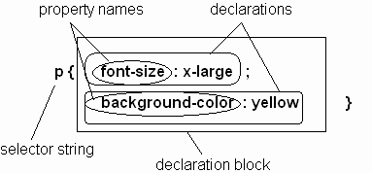
Concept of CSS 3:CSS Properties
Parts of a style rule (or statement)
methods: abs, ceil, cos, floor, log, max, min, pow, random, round, sin, sqrt, tan
properties: E, PI
Deepshikha WT 3

Slide 40
Concept of CSS 3:CSS Properties
Single element type:
Multiple element types:
5 < "7" is true
All element types:
Specific elements by id:

Slide 41
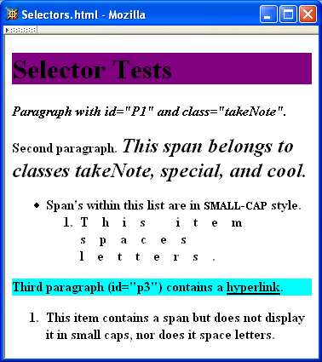
Concept of CSS 3:CSS Properties

Slide 42
Concept of CSS 3:CSS Properties
Elements belonging to a style class:
Referencing a style class in HTML:
Elements of a certain type and class:
class selector: begins with a period .

Slide 43
Concept of CSS 3:CSS Properties
lements belonging to a style class:
Elements of a certain type and class:
this span belongs to three style classes
Deepshikha WT Unit-3

Slide 44
Daily Quiz
Q1. Which of the following is NOT a method of creating a style sheet in web technology?
(A) Inline styles
(b) Internal styles
© External styles
(d) Embedded styles
Q2.What is the purpose of using CSS classes in a style sheet?
(a) To define styles for HTML elements that share the same class attribute
(b) To define styles for the entire HTML document.
(C) To link external style sheets
(d) To create inline styles for specific elements.
Q3.How can you add comments in a CSS file ?
(A) /* This is a comment */
(b) <!-- This is a comment -->
© // This is a comment
(D) <!--- This is a comment --->

Slide 45
Daily Quiz(cont..)
Q4.What is the purpose of the "cascading" in Cascading Style Sheets (CSS)
(A)It refers to the process of combining multiple style sheets into one
(B)It ensures that styles are applied in a specific order based on their priority.
(c) It enables the use of colors and gradients in CSS.
(D) It allows the creation of animated effects using CSS.
Q5.In the context of CSS specificity, which selector has the highest priority
(A)Element selectors (e.g., p, h1, div)
(B). Class selectors (e.g., .my-class)
©.ID selectors (e.g., #my-id)
(D). Universal selectors (*)
Q6. Which CSS property is used to change the font size of an element's text?
font-size
text-size
font-style
text-font

Slide 46
Daily Quiz(cont..)
Q. 7 What is the correct way to define an inline style in HTML?
a) <style>body {color: blue;}</style>
b) <link rel="stylesheet" type="text/css" href="styles.css">
c) Testing, Updation, Testing
d) <head><style>body {background-color: yellow;}</style></head>
Q. 8 To create an external style sheet, you use a file with which extension
a) .style
b) .style-sheet
c) .css
d).html
Q. 9 Which HTML tag is used to link an external style sheet to an HTML document?
a) <stylesheet>
b)<style>
c) <link>
d) <css>

Slide 47
Daily Quiz(cont..)
Q 10 Which of the following options correctly implements the required CSS rule in "styles.css"?
a) /* styles.css */
.highlight {
color: green;
}
b) /* styles.css */
div p {
color: green;
}
c) /* styles.css */
p {
color: green;
}
d) /* styles.css */
#highlight {
color: green;
}

Slide 48
Daily Quiz(cont..)
Q 12 The expression scroe = scroe +10 can be written as
scrore += 10;
scroe ++= 10;
score =+ 10;
score + 10 = 10;
Q 13 The correct reslut of score = 2 + 4 + "3" is:
9
27
63
6
Q 14. Assignment Operators is following type of operator ______________.
None of these
Unarry
Binary
Ternary
Q 15 "Add and Assignment" operator is shown by this symbol.
==+
+==
=+
+=

Slide 49
Daily Quiz(Cont..)
Q 16. Which CSS property is used to control the space between lines of text in an element?
A. letter-spacing B. word-spacing
C. word-spacing D. text-spacing
Q 17. How can you make text inside an element italic in CSS?
A. text-style: italic; B. font-style: italic;
C. text-decoration: italic; D. font-italic: true;
Q 18. Which CSS property is used to create rounded corners on an element's border? A. border-radius B. border-style
C. border-width D. border-corner-radius
Q 19. The CSS property "text-align" is used to:
A. Set the color of the text inside an element.
B. Control the alignment of an element's border C. Align the content of an element to the left, right, center, or justify
D. Define the font size of an element's text.

Slide 50
Daily Quiz (Cont..)
Q 20. How can you apply a 1-pixel solid red border to an element with the class "box" in CSS??
A. .box { border: solid red 1px; }
B. .box { border: 1px red solid; }
C. .box { border: red 1px solid; }
D. .box { border: 1px solid red; }

Slide 51
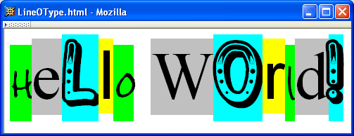
Concept of CSS 3:CSS Styling
A font is a mapping from code points to glyphs.
Deepshikha WT Unit-3

Slide 52
Concept of CSS 3:CSS Styling
A font family is a collection of related fonts (typically differ in
size, weight, etc.)
font-family property can accept a list of families, including generic font families
first choice font
`
Deepshikha WT Unit-3

Slide 53
Concept of CSS 3:CSS Styling
A font family is a collection of related fonts (typically differ in size, weight, etc.)
font-family property can accept a list of families, including generic font families
Depshikha WT Unit-3

Slide 54
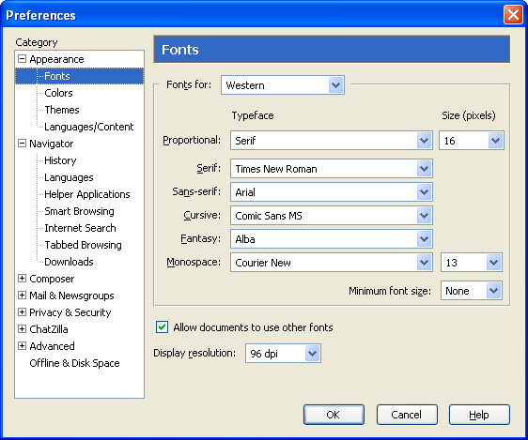
Concept of CSS 3:CSS Styling
Deepshikha WT Unit-3

Slide 55
Common HTML Events
Note that most generic font can be easily set on Firefox and Chrome, but such option doesn’t seem to be available on IE 7 and 8. IE will still default to something although maybe not what you had hoped for!
Pratik Singh WT Unit-3

Slide 56
Concept of CSS 3:CSS Styling
Things that should be done every time a page loads
Things that should be done when the page is closed
Action that should be performed when a user clicks a button
Content that should be verified when a user inputs data
HTML event attributes can execute JavaScript code directly
HTML event attributes can call JavaScript functions
You can assign your own event handler functions to HTML elements
You can prevent events from being sent or being handled
Deepshikha WT Unit-3

Slide 57
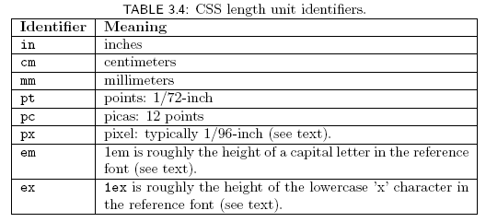
Concept of CSS 3:CSS Styling
Many properties, such as font-size, have a value that is a CSS length
All CSS length values except 0 need units

Slide 58
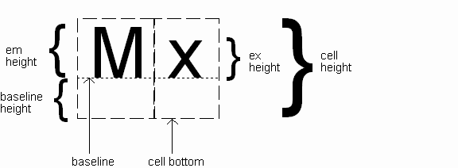
Concept of CSS 3:CSS Styling
Computed value
of font-size property

Slide 59
Concept of CSS 3:CSS Styling
Reference font defines em and ex units
Normally, reference font is the font of the element being styled
Exception: Using em/ex to specify value for font-size

Slide 60
Concept of CSS 3:CSS Styling
Other ways to specify value for font-size:
Percentage (of parent font-size) Absolute size keyword: xx-small, x-small, small, medium (initial value), large, x-large, xx-large
User agent specific; should differ by ~ 20%
Relative size keyword: smaller, larger
Relative to parent element’s font

Slide 61
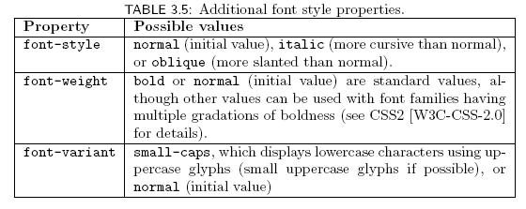
Concept of CSS 3:CSS Styling

Slide 62

Concept of CSS 3:CSS Styling
Text is rendered using line boxes
Height of line box given by line-height
Initial value: normal (i.e., cell height; relationship with em height is font-specific)
Other values (following are equivalent):

Slide 63
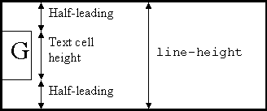
Concept of CSS 3:CSS Styling
When line-height is greater than cell height:
Inheritance of line-height:
Specified value if normal or unit-less number
Computed value otherwise

Slide 64
Concept of CSS 3:CSS Styling
font shortcut property:

Slide 65
Concept of CSS 3:CSS Styling
font shortcut property:
any order
specifying line-height (here, twice cell height)

Slide 66
Concept of CSS 3:CSS Styling

Slide 67

Concept of CSS 3:CSS Styling
Font color specified by color property
Two primary ways of specifying colors:
Color name: black, gray, silver, white, red, lime, blue, yellow, aqua, fuchsia, maroon, green, navy, olive, teal, purple, full list at http://www.w3.org/TR/SVG11/types.html#ColorKeywords
red/green/blue (RGB) values

Slide 68
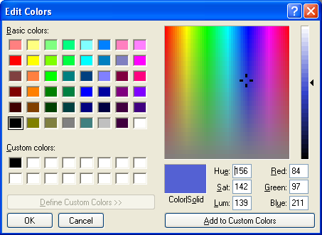
Concept of CSS 3:CSS Styling

Slide 69
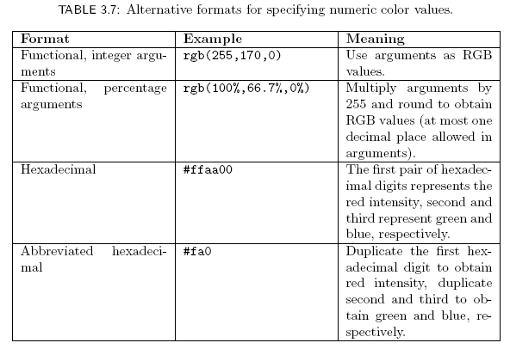
Concept of CSS 3:CSS Styling

Slide 70
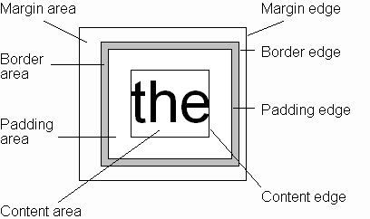
Concept of CSS 3:CSS Box Model
Every rendered element occupies a box:

Slide 71
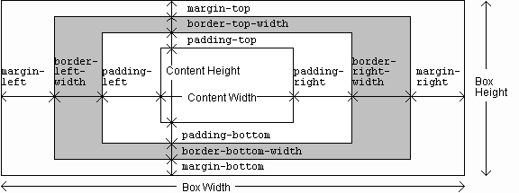
Concept of CSS 3:CSS Box Model

Slide 72
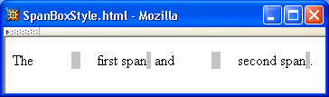
Concept of CSS 3:CSS Box Model

Slide 73
Concept of CSS 3:CSS Box Model

Slide 74
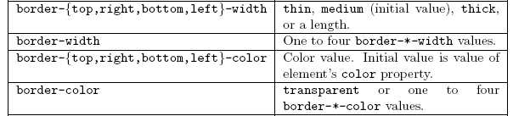
Concept of CSS 3:CSS Box Model

Slide 75
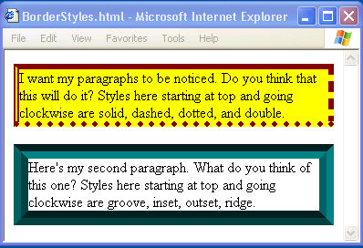
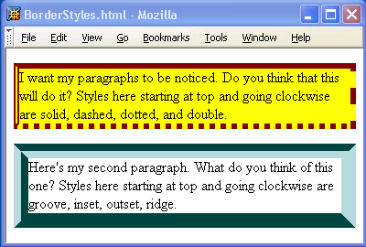
Concept of CSS 3:CSS Box Model

Slide 76
Concept of CSS 3:CSS Box Model

Slide 77
Concept of CSS 3:CSS Box Model
If multiple declarations apply to a property, the last declaration overrides earlier specifications
Left border is 30px wide,
inset style, and red

Slide 78
Daily Quiz
Using the <style> element within the HTML file
Using the <style> element within the HTML file
Q 1 Which of the following options correctly describes the usage of CSS styles in web technology?
CSS is used to structure the content of a web page, such as defining headings, paragraphs, and lists.
CSS is used to add interactivity and dynamic behavior to a web page, such as handling user interactions and form validations
CSS is used to define the layout and presentation of a web page, such as setting colors, fonts, and spacing
CSS is used to define the server-side logic and database connections for a web application
Q 2 Which CSS property is used to change the text color of an element?
text-color
color
font-color
text style
Q 3 How can you apply external CSS styles to an HTML document?
Using the ‘<style>’ element within the HTML file.
Using the ‘style’ attribute in HTML tags.
Using the’link’ element with the ‘rel’ attribute set to ‘stylesheet’.
Using the ‘css’ in the head section of the HTML file.

Slide 79
Daily Quiz(cont..)
Q 4. What does CSS stand for
a)Creative Style Sheets
b) Computer Style Sheets
c) Cascading Style Sheets
d) Colorful Style Sheets
Q 5 Which HTML tag is used to link an external CSS file to an HTML document?
a)<script>
b) <css>
c) <link>
d) <style>
Q 6 The CSS property used to add spacing between lines of text is:
line-height b) letter-spacing c) text-spacing d) line-spacing
Q 7 How can you set the background color of an element in CSS
background-color
b) bg-color
c) color-background
d) background-style

Slide 80
Daily Quiz(cont..)
Q 8 What is the Box Model in CSS?
a)A design technique for creating 3D boxes in web pages.
b) A layout model that arranges elements in a grid pattern.
c) A concept that describes how elements are rendered as rectangular boxes.
d) A method for creating responsive web designs.
Q 9 Which CSS property is used to create rounded corners on elements
a)border-radius
b) corner-radius
c) rounded-style
d) border-style
Q 10 How can you center an element horizontally in CSS?
a)align: center;
b) horizontal-align: center;
c) margin: auto;
d) center: true;
Q 11 What is the correct way to select an element with the ID "header" in CSS?
#header
b) .header
c) header
d) id(header)

Slide 81
Daily Quiz(cont..)
Q 12 Which of the following properties is NOT part of the Box Model?
a)border b) margin c) padding d) float
Q 13 In the Box Model, the total width of an element is calculated as:
a)width + margin + padding + border
b) width + margin + padding
c) width + padding + border
d) width + margin + border
Q 14 Which CSS property is used to set the space between an element's content and its border?
border-width b) margin c) padding d) border-spacing
Q 15 The CSS property "box-sizing" is used to control how the total width and height of an element are calculated. What are the possible values for "box-sizing"?
a)content-box and padding-box
b) border-box and content-box
c) margin-box and padding-box
d) border-box and padding-box
Q 16 The CSS property "border-radius" is used to:
a)set the width of an element's border.
b) create rounded corners on an element.
c) adjust the spacing between an element's border and content.
d) align an element horizontally within its parent container.

Slide 82
Daily Quiz(cont..)
Q 17 What will be the total width of an element with a width of 200px, a padding of 20px on the left and right sides, and a border of 2px on the left and right sides?
a)224px
b) 242px
c) 204px
d) 220px
Q 18 If an element has a width of 300px, padding of 10px, and a border of 5px, what will be the total width of the element when "box-sizing" is set to "border-box"?
300px
b) 320px
c) 330px
d) 340px
Q 19 The "padding-bottom" property in CSS is used to set:
the space between an element's border and its content on the bottom side.
b) the space between an element's border and its content on all sides.
c) the space between an element's border and its parent container on the bottom side.
d) the space between an element's border and its parent container on all sides.
Q 20 The "margin" property in CSS is used for:
adding space between an element's content and its border.
b) setting the width of an element's border.
c) positioning an element within its parent container.
d) adding space between an element and its neighboring elements.

Slide 83
Concept of CSS 3:CSS Advanced(Grouping styles)
You can give the same properties to a number of selectors without having to repeat them by separating the selectors by commas. It is a useful thing for reducing file size.
Example
h2
{
color: red;
}
.thisOtherClass
{
color: red;
}
.yetAnotherClass
{ color: red; }
h2, .thisOtherClass, .yetAnotherClass
{
color: red;
}
h1, h2, h3, h4, h5, h6
{
color: blue;
}

Slide 84
Concept of CSS 3:CSS Advanced(Nested Styles)
If the CSS is structured well, there shouldn't be a need to use many class or ID selectors. This is because you can specify properties to selectors within other selectors.
#top { background-color: #ccc; padding: 1em }
#top h1 { color: #ff0; }
#top p { color: red; font-weight: bold; }

Slide 85
Concept of CSS 3:CSS Advanced(Conditional CSS)
a[href $='.pdf'] { padding-right: 18px; background: transparent url(icon_pdf.gif) no-repeat center right; }
This would attach a pdf icon to the right of any hyperlink who's URL ended in '.pdf' like this. This was pretty exciting and heady stuff. It meant I could show the file type visually with that application's icon just by including a few lines in my master css file. I didn't have to worry about it at all in my html, css would add the icon for me automatically.

Slide 86
Concept of CSS 3:CSS Advanced
span[id ^='google'] { background-color: green; }
Any span which has an id which starts with 'google' will be assigned a green background.
More Examples

Slide 87
Concept of CSS 3:CSS Advanced
.ie .example { background-color: yellow } .gecko .example { background-color: gray } .opera .example { background-color: green } .konqueror .example { background-color: blue } .webkit .example { background-color: black } .example { width: 100px; height: 100px; background-color: brown; }

Slide 88
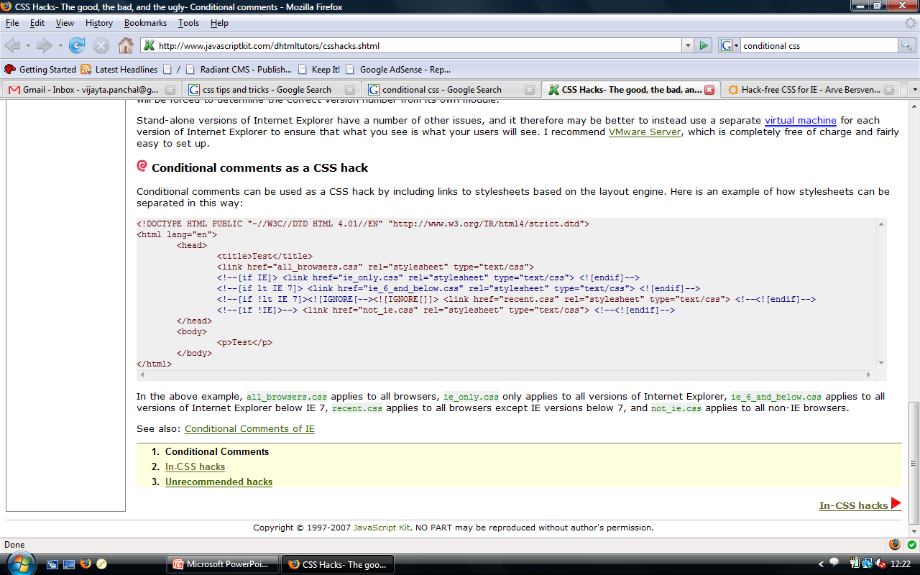
Concept of CSS 3:CSS Advanced(Cont..)
Function expressions can be made "self-invoking".
A self-invoking expression is invoked (started) automatically, without being called.
Function expressions will execute automatically if the expression is followed by ().
You cannot self-invoke a function declaration.
we have to add parentheses around the function to indicate that it is a function expression:
Example
(function () { let x = "Hello!!"; // I will invoke myself })();
The function above is actually an anonymous self-invoking function (function without name)

Slide 89
Concept of CSS 3:CSS Advanced(Validation)(Cont..)
Validate your HTML validator.w3.org
Validate your CSS jigsaw.w3.org/css-validator/
Check for web accessibility bobby.watchfire.com

Slide 90
Daily Quiz
Q 1 In CSS, what does the "+" selector do?
Selects the first child element of the parent.
b) Selects all elements that are immediately preceded by a sibling element.
c) Selects all child elements of the parent.
d) Selects all elements with a specific attribute
Q 2 The CSS property "box-shadow" is used for:
a)Adding a shadow behind an element's border-box.
b) Adding a shadow inside an element's content-box.
c) Changing the shape of an element's box.
d) Creating a border around an element.
Q 3 The "z-index" property in CSS is used to control:
The positioning of an element along the z-axis (depth).
b) The size of an element's width and height.
c) The positioning of an element within its parent container.
d) The spacing between an element's border and content.
Q 4 How can you make an element "float" in CSS?
a)float: left; b) position: float; c) display: float; d) align: float;
Q 5 Which CSS property is used to change the size of an element's font?
a) font-size b) text-size c) font-style d) size

Slide 91
Daily Quiz(Cont..)
Q 6 What is the purpose of CSS image sprites?
a)Combining multiple images into a single image to reduce HTTP requests.
b) Adding decorative elements to the background of a webpage.
c) Applying different styles to elements based on their attribute values.
d) Animating images on a webpage.
Q 7 How can you center an element both horizontally and vertically in CSS?
a)center: horizontal vertical;
b) position: center center;
c) display: center;
d) margin: auto;
Q 8 Which CSS property is used to set the space between lines of text within an element?
a) line-spacing b) line-height c) text-spacing d) font-line
Q 9 What is the purpose of a navigation bar in web development?
It is used to store and organize data related to a website's users.
b) It is used to display images and videos on a webpage.
c) It is used to create interactive menus for website navigation.
d) It is used to define the structure and layout of a webpage.
Q 10 The CSS pseudo-class ":hover" is used to apply styles:
When an element is clicked.
b) When an element is focused.
c) When an element is hovered over with the mouse pointer.
d) When an element is the first child of its parent.

Slide 92
Daily Quiz(Cont..)
Q 12 The CSS property "display: flex;" is used for:
Creating animations on a webpage.
b) Styling form elements like buttons and inputs.
c) Creating a responsive layout with flexible boxes.
d) Applying a gradient background to an element.
Q 13 How can you select all elements with the attribute "target" set to "_blank" in CSS?
a) target="_blank“
b) [target="_blank"]
c) :target="_blank"
d) :target[_blank]
Q 14 The CSS property "position: fixed;" is used to:
Position an element relative to its parent container.
b) Position an element relative to the viewport, even when scrolling.
c) Make an element float above other elements in the stacking order.
d) Create a fixed-width container for the element.
Q 15 How can you select the first child element of a parent using CSS?
a) :first-child
b) first-child
c) .first-child
d) #first-child

Slide 93
Daily Quiz(Cont..)
Q 16 The CSS pseudo-element "::before" is used to:
Insert content before the content of an element.
b) Select an element that comes before another specific element.
c) Style the first line of an element's text.
d) Create a new block-level container within an element.
Q 17 The CSS property "clear" is used to:
Clear all styles applied to an element.
b) Prevent an element from floating next to a floated element.
c) Remove the background color of an element.
d) Change the color of the text inside an element.
Q 18 What is the purpose of the CSS attribute selector?
It allows you to select elements based on their position within the HTML document.
b) It allows you to select elements based on their class names or IDs.
c) It allows you to select elements based on their attributes and attribute values.
d) It allows you to group elements together and apply styles collectively.
Q 19 The CSS property "float" is commonly used for:
Adding shadows to an element.
b) Creating rounded corners on an element.
c) Positioning an element to the left or right and allowing other content to wrap around it.
d) Applying a gradient background to an element.
Q 20 Which value of the "display" property is used to hide an element from the page layout but still reserves its space?
hidden
b) invisible
c) none
d) collapse

Slide 94
Concept of CSS 3:Bootstrap
Bootstrap is the most popular HTML, CSS, and JavaScript framework for developing responsive, mobile-first web sites.
Advantages of Boot Strapping-
Easy to use: Anybody with just basic Knowledge of HTML and CSS can start using Bootstrap.
Responsive features: Bootstrap’s responsive CSS adjusts to phones, tablets, and desktops.
Mobile –First approach: In Bootstrap 3, mobile first styles are part of the core framework.

Slide 95
Concept of CSS 3:Bootstrap
This is the strongest part of bootstrap framework. Bootstrap offers a 12 column grid system. The grid system is responsive, that it adjust itself depending upon the device resolution of the client. These grids have further classes that have been defined in sync with the device resolution that they are represent.
These grids have classes xs, sm, md and lg each representing a device resolution. All the developer needs to do is include these classes while defining the visibility of element in the mark-up and hence come up with a responsive website. The responsive grid makes developing responsive websites really easy using bootstrap.

Slide 96
Concept of CSS 3:Bootstrap
Bootstrap Components
Bootstrap.css
This is the basic Bootstrap package that you will need to download. CSS is a style sheet language for static information.
Bootstrap.js
A JavaScript/JQuery library that powers up certain components of Bootstrap such as animation, scrolling, and interactivity.
Glyphicons
Glyphs are elemental symbols with typography, such as the English Pound symbol (£). Bootstrap has a huge list of embedded glyph icons that are available for free.

Slide 97
Concept of CSS 3:Bootstrap
Bootstrap source code elements
Bootstrap Screen Sizes The Bootstrap source code download includes the precompiled CSS, JavaScript, and font assets, along with source Less, JavaScript, and documentation.
less/ - a preprocessor style sheet for CSS that eliminate repetitive coding tasks
sass/ - a newer version of the preprocessor that is more popular
js/ - simply refers to the source code JavaScript, which allows Bootstrap components to work
fonts/ - these are icon fonts that come with the download
dist/ - a folder that contains precompiled files for drop-in use in website development

Slide 98
Daily Quiz
Q 1 What is Bootstrap?
A JavaScript library for building interactive web applications.
b) A framework for creating responsive and mobile-first websites.
c) A programming language for server-side web development.
d) An image editing software for web designers.
Q 2 Which CSS preprocessor is used in Bootstrap?
a) Sass
b) Less
c) Stylus
d) CSS is not used in Bootstrap.
Q 3 The Bootstrap grid system is based on how many columns?
a) 10 b) 12 c) 16 d) 24
Q 4 . In Bootstrap, the "container" class is used to:
a)Create a fixed-width container for the content.
b) Create a full-width container that spans the entire viewport.
c) Define the position of an element within its parent container.
d) Style the font of the text inside the container.
Q 5 The class "col-md-6" in Bootstrap represents:
a) A column with a width of 6 pixels.
b) A column that spans 6 columns out of 12 in medium-sized screens.
c) A column that spans 6 columns out of 12 in all screen sizes.
d) A column that spans 6 columns in extra-large screens.

Slide 99
Daily Quiz(Cont..)
Q 6 What is the purpose of the Bootstrap "navbar" component?
To display images and videos on a webpage.
b) To create a responsive layout with flexible boxes.
c) To add rounded corners to elements.
d) To create a navigation bar for website navigation.
Q 7 Which Bootstrap class is used to create a responsive, fixed-width container that centers the content?
.container-fixed
b) .container-fluid
c) .container-responsive
d) .container-center
Q 8 The Bootstrap "btn" class is used for styling:
Navigation bars.
b) Buttons.
c) Tables.
d) Forms.
Q 9 Which class is used to create a responsive image in Bootstrap that scales with the size of its parent container?
a) .img-responsive b) .img-fluid c) .img-scale d) .img-fit
Q 10 The Bootstrap "modal" component is used for:
a) Creating responsive grid layouts.
b) Displaying alerts and notifications.
c) Creating pop-up windows for dialogues or messages.
d) Styling buttons and links.

Slide 100
Daily Quiz(Cont..)
Q 11 Which Bootstrap class is used to create a flexible, responsive card container that can hold various types of content?
a) .card-container b) .box c) .panel d) .card
Q 12 What is the purpose of Bootstrap "glyphicons"?
To style text and headings on a webpage.
b) To create animated effects on elements.
c) To display icons and symbols on a webpage.
d) To add rounded corners to images.
Q 13 Which class is used to create a progress bar in Bootstrap?
a) .progress-bar b) .loading-bar c) .progress-indicator d) .bar-fill
Q 14 What is the purpose of the Bootstrap Modal component?
a) To display images in a gallery
b) To create pop-up advertisements
c) To show additional content on a page
d) To display a dialog box on top of the current page
Q 15 What is the purpose of the "data-toggle" attribute in Bootstrap?
It enables data binding with a back-end server.
b) It activates Bootstrap components using JavaScript.
c) It defines the structure of the HTML document.
d) It sets the default styling for all Bootstrap elements.

Slide 101
Daily Quiz(Cont..)
Q 16. Which Bootstrap class is used to create a collapsible accordion?
a) .collapse b) .collapsible c) .accordion d) .expandable
Q 17 How can you add dropdown menus to a navigation bar in Bootstrap?
By using the .dropdown class inside a .nav-item
b) By using the .nav-dropdown class inside a .navbar
c) By using the .dropdown-menu class inside a .nav-link
d) By using the .navbar-dropdown class inside a .navbar-item
Q 18 Which class is used to create responsive, equal-width columns in Bootstrap?
a) .col-fixed b) .col-fluid c) .col-equal d) .col
Q 19 How do you integrate Bootstrap into your web project?
a) By copying and pasting Bootstrap files directly into your project directory
b) By using a CDN link to include Bootstrap's CSS and JS files in your HTML
c) By converting your project to a Bootstrap-specific file format
d) By installing Bootstrap as a Python package
Q 20 Which version of HTML does Bootstrap primarily support?
a) HTML4 b) HTML5 c) XHTML d) XML

Slide 102
BootStrap Plugins
Bootstrap provides custom events for most plugin's unique actions. Generally, these events come in two forms − Infinitive form − This is triggered at the start of an event. E.g. show. Infinitive events provide preventDefault functionality.
Form Plugins:
Table Plugins
Menu & Navigation Plugins
Notification Plugins
Modal Plugins
Button Plugins
Other Plugins

Slide 103
Daily Quiz
Q 1 What are Bootstrap plugins?
External JavaScript libraries that extend Bootstrap functionality
b) CSS stylesheets to customize Bootstrap components
c) Custom Bootstrap templates for different industries
d) Bootstrap's built-in design tools
Q 2 Which attribute is used to enable the Bootstrap Tooltip plugin?
a) data-toggle="tooltip"
b) data-tooltip="true"
c) data-tooltip="enable"
d) data-tooltip="bootstrap”
Q 3 What is the purpose of the Bootstrap Modal plugin?
a)To create image galleries
b) To display additional information on a target element
c) To validate form fields
d) To display a pop-up dialog box on top of the current page
Q 4 Which Bootstrap plugin is used to add a date picker to form fields?
a) Datepicker.js b) Calendar.js c) Datetimepicker.js d) DatePicker.plugin
Q 5 How do you enable the Bootstrap Collapse plugin for an element?
a) data-collapse="true" b) data-toggle="collapse" c) data-plugin="collapse" d) data-collapseable="true“
Q 6 Which Bootstrap plugin is used for creating a carousel or image slider?
a) Slideshow.js b) Carousel.js c) Slider.js d) Glide.js
Q 7 What is the purpose of the Bootstrap Popover plugin?
a) To display image galleries
b) To create dynamic pop-up ads
c) To provide additional information on hover
d) To create fixed-position notifications

Slide 104
Daily Quiz(Cont..)
Q 8 Which class is used to enable the Bootstrap Scrollspy plugin?
a) .scrollspy b) .spy c) .scroll d) .scroll-plugin
Q 9 Which Bootstrap plugin is used to enhance the appearance of HTML tables?
a) DataTables b) TableStyles c) EnhancedTables d) BootstrapTables
Q 10 What is the function of the Bootstrap Affix plugin?
To fix the navigation bar at the bottom of the page
b) To toggle the visibility of elements on scroll
c) To create sticky elements that stick to the top of the page
d) To animate scrolling within the page
Q 11 Which attribute is used to activate the Bootstrap Dropdown plugin?
data-plugin="dropdown“
b) data-toggle="dropdown"
c) data-dropdown="true"
d) data-target="dropdown“
Q 12 Which Bootstrap plugin is used to add a Google Maps display to a webpage?
GoogleMaps.js
b) MapEmbed.js
c) GMaps.js
d) MapsAPI.js

Slide 105
Daily Quiz(Cont..)
Q 13 What is the purpose of the Bootstrap Typeahead plugin?
To create animated text effects
b) To autocomplete user input in text fields
c) To format text in a specific font
d) To create scrolling text elements
Q 14 Which class is used to enable the Bootstrap Tab plugin?
.tab
b) .tabs
c) .tabbable
d) .tab-toggle
Q 15 What is the purpose of the Bootstrap Affix plugin?
a) To fix the navigation bar at the bottom of the page
b) To toggle the visibility of elements on scroll
c) To create sticky elements that stick to the top of the page
d) To animate scrolling within the page
Q Which Bootstrap plugin is used to add video players to a webpage?
VideoPlayer.js
b) Media.js
c) Video.js
d) MediaPlayer.js

Slide 106
Daily Quiz(Cont..)
Q 17 How do you enable the Bootstrap Popover plugin for an element?
data-popover="true"
b) data-toggle="popover"
c) data-tooltip="enable"
d) data-popup="enable“
Q 18Which Bootstrap plugin is used for form validation?
Validate.js
b) FormValidator.js
c) BootstrapValidator.js
d) ValidForm.js
Q 19 What is the purpose of the Bootstrap Tooltip plugin?
a) To display alert messages
b) To create animated banners
c) To provide additional information on hover
d) To validate form fields
Q 20 Which Bootstrap plugin is used to create a responsive, multi-level menu?
MultiMenu.js
b) MegaMenu.js
c) DropdownMenu.js
d) SubMenu.js

Slide 107
Weekly Assignment
Explain Background Properties and Typography Properties? [CO3]
Explain Text Formatting and Controlling Fonts in CSS. [CO3]
Define Advanced Background Patterns in CSS. [CO3]
Explain Image Gallery with CSS Grid . [CO3]
Define Building a Product Gallery.[CO3]
What is Flexbox and Grid Layout Properties. [CO3]
How to Creating a Two-Column Layout ? [CO3]
What are the different levels of headings in HTML ? [CO3]
How to Creating a Navigation Bar and Styling a Contact Form. [CO3]
How to create a Data Table,Styling Table Header and Responsive Table. [CO3]

Slide 108
MCQ s
Q 1 Which CSS property is used to group multiple selectors together and apply the same styles to all of them?
a) grouping
b) merge
c) combine
d) comma
Q 2 Image sprites are used in CSS to:
a) Display images in a slideshow format.
b) Combine multiple images into a single image file to reduce HTTP requests.
c) Create rounded corners on images.
d) Change the color of an image.
Q 3 Which CSS pseudo-class is used to select and style the first letter of a block-level element?
a) :first-line
b) :first-letter
c) :first-child
d) :first-of-type

Slide 109
MCQs(Cont..)
Q 4. The CSS property "display: inline-block" is used for elements to:
a) Make them appear on the same line as inline elements.
b) Display them as block-level elements.
c) Hide them from the page.
d) Create an animation effect.
Q 5.The CSS property "max-width" is used to:
a) Set the maximum width of an element.
b) Define the minimum width of an element.
c) Set the width of an element relative to its parent container.
d) Make an element invisible if it exceeds a certain width.
Q 6.What is the purpose of the Bootstrap Scrollspy plugin?
a) To add smooth scrolling animations to the website.
b) To display a list of related links in a dropdown menu.
c) To keep the navigation bar fixed at the top of the page.
d) To highlight the active section in the navigation based on the user's scroll position.

Slide 110
MCQs(Cont..)
Q 7 .The CSS "text-align" property is used to:
a) Set the alignment of an element within its container.
b) Define the shape of an element.
c) Set the spacing between characters in text.
d) Control the display of text when it overflows its container.
Q 8 .The CSS property "list-style-type" is used to:
a) Set the color of the text within a list item.
b) Change the font family of the list items.
c) Define the style of the bullet points or numbering in a list.
d) Adjust the spacing between list items.
Q 9 . The "display: inline" CSS property is used for block elements to:
a) Make them appear on the same line as inline elements.
b) Hide them from the page.
c) Give them a fixed width and height.
d) Apply a background image to them.

Slide 111
MCQs(Cont..)
Q 10. The CSS property "font-size" is used to:
a) Set the color of the font.
b) Define the width and height of an element.
c) Control the size of the font.
d) Set the font style (italic, bold, etc.)
.Q 11 In CSS, which of the following properties is used to specify the font family for an element?
a) font-family
b) font-style
c) font-weight
d) font-size
Q 12.Which Bootstrap plugin provides a popover that appears when the user hovers over an element?
a) Tooltip
b) Popover
c) Collapse
d) Scrollspy

Slide 112
MCQ s(Cont..)
Q 13. How does the Bootstrap grid system handle responsive design?
a) It uses media queries to adapt the layout for different screen sizes.
b) It automatically scales images based on the device's screen resolution.
c) It hides elements on smaller screens to improve performance.
d) It uses JavaScript to detect the device's screen size.
Q 14 IWhich of the following Bootstrap plugins is used to create responsive and interactive navigation bars?
a) Typeahead
b) Scrollspy
c) Navbar
d) Tooltip
Q 15 Which Bootstrap plugin allows you to create modal dialogs with custom content?
a) Modal
b) Popover
c) Dropdown
d) Collapse

Slide 113
MCQ s(Cont..)
Q 16 In the Bootstrap grid system, how many columns does the grid layout consist of? a) 6
b) 9
c) 12
d) 15 Q 17 Which CSS classes are used to create a row in the Bootstrap grid system?
a) .row
b) .container
c) .col
d) .grid
Q 18 What class is used to make an element visible only on small devices in Bootstrap?
a) .hidden-md
b) .visible-sm
c) .hidden-xs
d) .visible-md

Slide 114
MCQ s(Cont..)
Q 19 What is the main purpose of the Bootstrap grid system?
a) To create animations and transitions.
b) To handle server-side processing.
c) To manage the layout and responsiveness of web pages.
d) To handle backend data storage.
Q 20 What is Bootstrap?
a) A server-side scripting language.
b) A front-end framework for web development.
c) A database management system.
d) A protocol for secure data transfer.

Slide 115

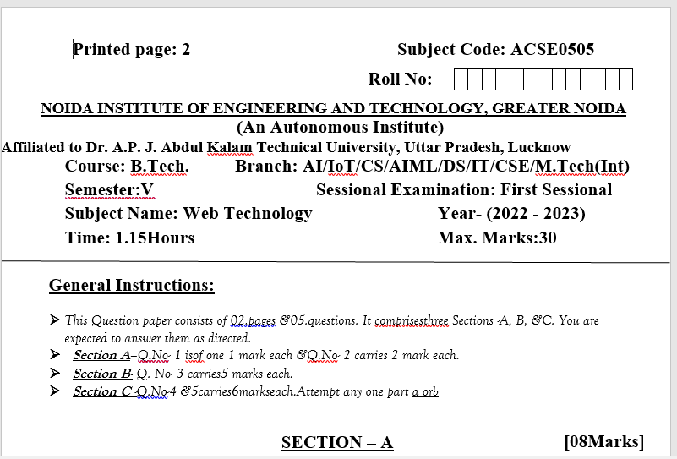
Sessional Papers

Slide 116
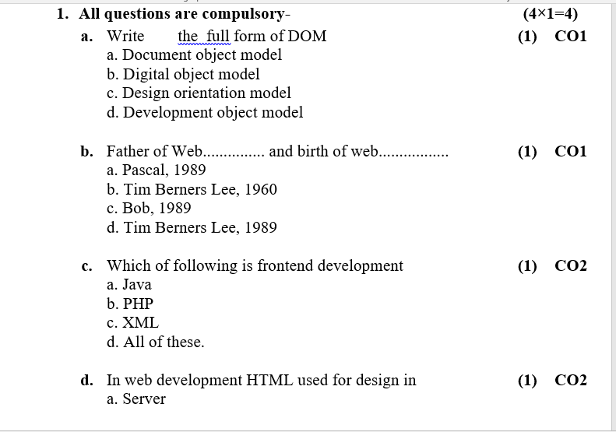
Sessional Papers

Slide 117
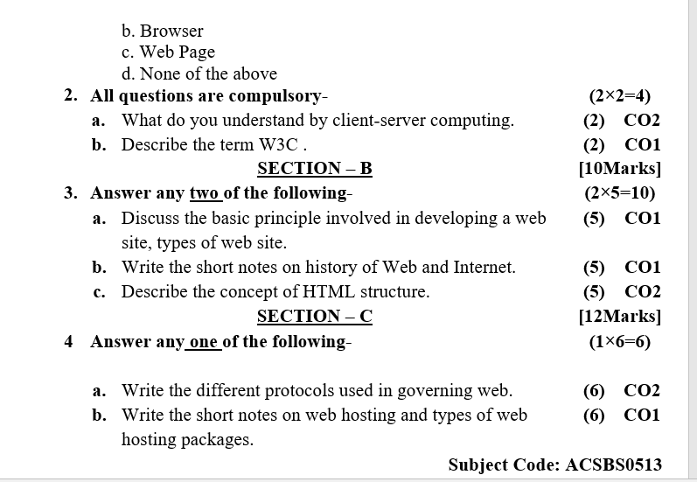
Sessional Papers

Slide 118
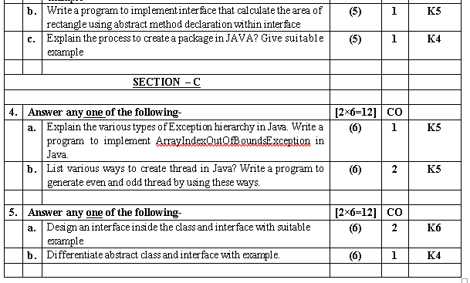
Sessional Papers

Slide 119
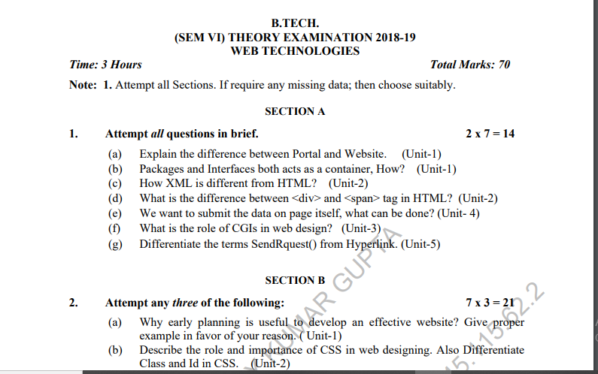
Old Question Paper

Slide 120
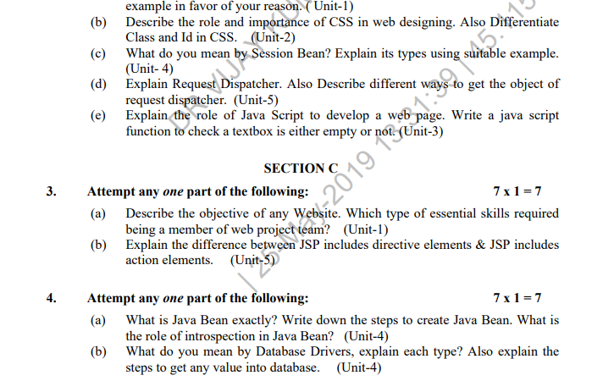
Old Question Paper(cont..)

Slide 121
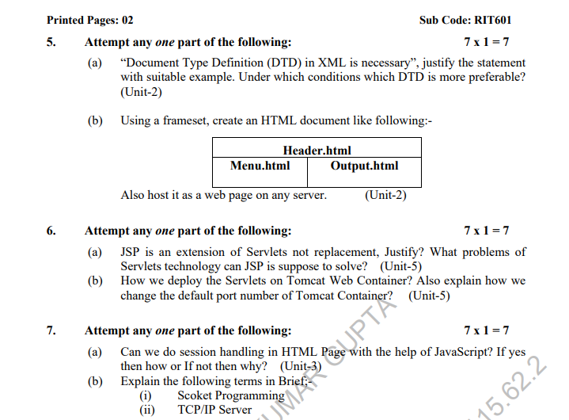
Old Question Paper(cont..)

Slide 122
References
Burdman, Jessica, “Collaborative Web Development” Addison Wesley
Xavier, C, “ Web Technology and Design” , New Age International
Ivan Bayross,” HTML, DHTML, Java Script, Perl & CGI”, BPB Publication

Slide 123
Recap of Unit 3
Discussed about the concepts of CSS and its advantages
Discussed about various types CSS with its uses and properties
Discussed the various types of Bootstrapping techniques in web technology.
Discussed about various fonts and color using CSS properties to make our page interactive.

Slide 124
NPTEL video / Other study links
Unit 1 | https://youtu.be/96xF9phMsWA
 | https://youtu.be/Zopo5C79m2k
 | https://youtu.be/ZliIs7jHi1s
 | https://youtu.be/htbY9-yggB0
Unit 2 | https://youtu.be/vHmUVQKXlVo
 | https://youtu.be/qz0aGYrrlhU
Unit 3 | https://youtu.be/1Rs2ND1ryYc
Unit 4 | https://youtu.be/-qfEOE4vtxE
 | https://youtu.be/PkZNo7MFNFg
Unit 5 | https://youtu.be/_GMEqhUyyFM

Slide 125
Thank You

